Slide 1
Indexing
Index Construction

Slide 2
Indexing
How do we construct an index?
What strategies can we use with limited main memory?

Slide 3
Hardware basics
Access to data in memory is much faster than access to data on disk.
Disk seeks: No data is transferred from disk while the disk head is being positioned.
Therefore: Transferring one large chunk of data from disk to memory is faster than transferring many small chunks.
Disk I/O is block-based: Reading and writing of entire blocks (as opposed to smaller chunks).

Slide 4
Data Structures Storing and fast accessing digital data is as old as computers themselves.
In general, which data structure is more suitable for indexing depends on the particular application
Boolean matching – term presence
Ranking algorithms – document length, term frequency, document frequency etc.
The amount of data to be indexed is an important factor.

Slide 5
Data Structure - Indexing techniques
Bitmap
Signature file
Inverted index

Slide 6
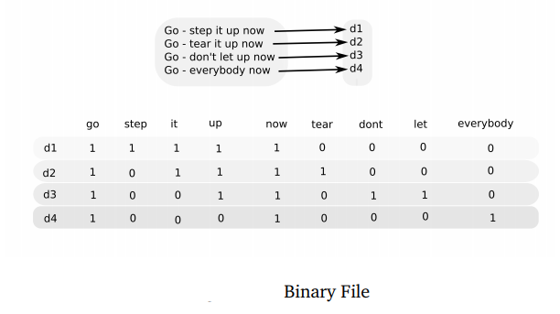
Data Structures - Bitmap
Simplest structure that provides keyword search
A bitmap is useful for environments that only require Boolean search

Slide 7
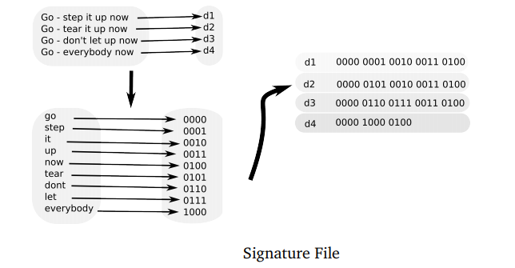
Data Structures – Signature file
SFs store a descriptor for every document, which is a bit-based fingerprint representation of its contents – word signatures, superimposed coding and compression-based methods:

Slide 8
Data Structures – Inverted Index
IFs need to store both a dictionary and a posting list file (also called concordance file).
Dictionary - contains the tokens indexed and global statistical information about them.
Posting list - contains information about which terms appear in which documents.
The dictionary is usually stored in main memory for fast retrieval, whereas the postings normally reside on disk.

Slide 9
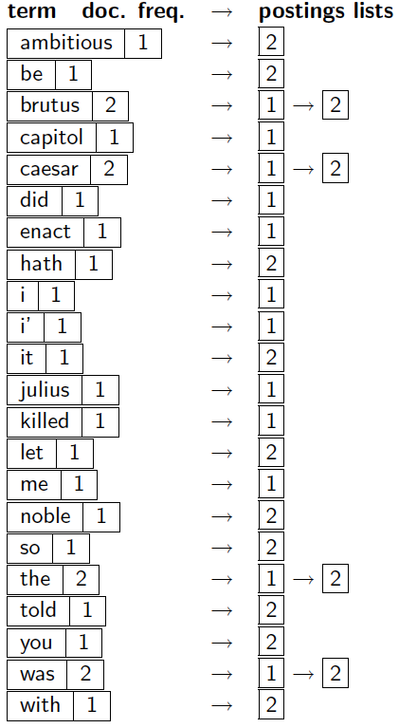
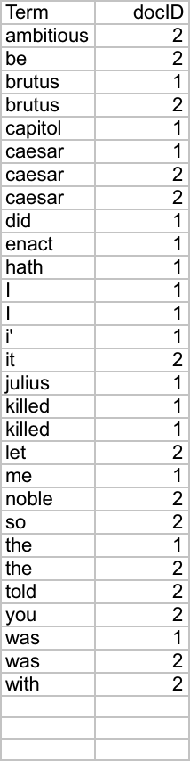
Indexer steps: Dictionary & Postings
Sec. 1.2
Doc. frequency information is added

Slide 10
Searching
The search algorithm on an inverted index follows three steps
Vocabulary search: the words present in the query
are searched in the vocabulary
Retrieval occurrences: the lists of the occurrences of all words found are retrieved
Manipulation of occurrences: the occurrences
are processed to solve the query

Slide 11
Scalability Issues: Number of Postings
An Example: Reuters RCV1 Collection
Number of docs = m = 800,000
Average tokens per doc: 200
Number of distinct terms = n = 400K
100 million (non-positional) postings in the inverted index

Slide 12
Dictionary lookup
First step - to look-up the dictionary file to see if the collection contains the search terms.(hashing tables, search trees, and the common dictionary-as-a-string)
The look-up process using hashing tables is very fast: it involves hashing the query term and performing an access in O(1) time. Hashing only provides results for exact term matching.
Search trees allow for suffix search. Search trees need to be balanced in order to achieve optimum efficiency - B tree
Suitable choice if the dictionary does not fit completely in main memory.

Slide 13

Postings file
The second data structure of an inverted file is the postings file or concordance file which contains the information of every term occurrence in a document
presence or absence of terms – frequency, position( HTML, text).
The simplest form only records binary occurrences of terms in documents:
effective ranked retrieval it is necessary to record frequency of terms. Posting list for term t is:

Slide 14
Inverted Files - construction
Building the index in main memory is not feasible (wouldn’t fit, and swapping would be unbearable)
Building it entirely in disk is not a good idea either (would take a long time)
Building several partial indices in main memory, one at a time, saving them to disk and then merging all of them to obtain a single index

Slide 15
Indexing Types
Basic Sort-based indexing
Blocked Sort-based indexing
Single-pass in-memory indexing
Distributed indexing
Dynamic indexing

Slide 16
Index Construction
Documents are parsed to extract words and these are saved with the Document ID.
I did enact Julius
Caesar I was killed
i' the Capitol;
Brutus killed me.
So let it be with
Caesar. The noble
Brutus hath told you
Caesar was ambitious

Slide 17
Index Construction
After all documents have been parsed, the inverted file is sorted by terms.
We focus on this sort step.
We have 100M items to sort.

Slide 18
Basic Sort-based indexing
As we build the index, we parse docs one at a time
Parse and build postings entries one doc at a time
Now sort postings entries by term (then by doc within each term)
Doing this with random disk seeks would be too slow – must sort T=100M records

Slide 19
Blocked Sort-based indexing
An efficient single-machine algorithm designed for static collections that can be viewed as a more scalable version of the basic sort-based indexing algorithm
Basic idea of algorithm:
Accumulate postings for each block, sort, write to disk.
Then merge the blocks into one long sorted order
Term | Termid
Brutus | 1
Caesar | 2

Slide 20
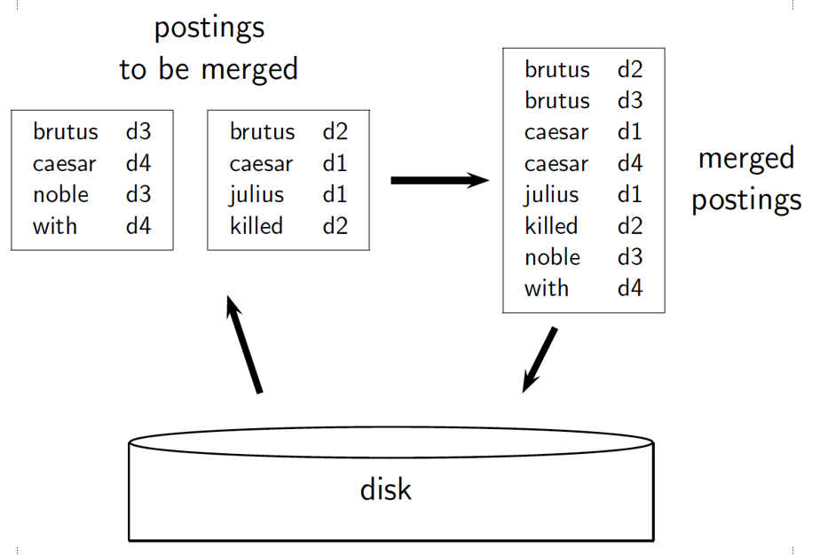
BSBI Example with two blocks: The two blocks (“postings lists to be merged”) are loaded from disk into memory, merged in memory (“merged postings lists”) and written back to disk. Terms are shown instead of termIDs for better readability.

Slide 21
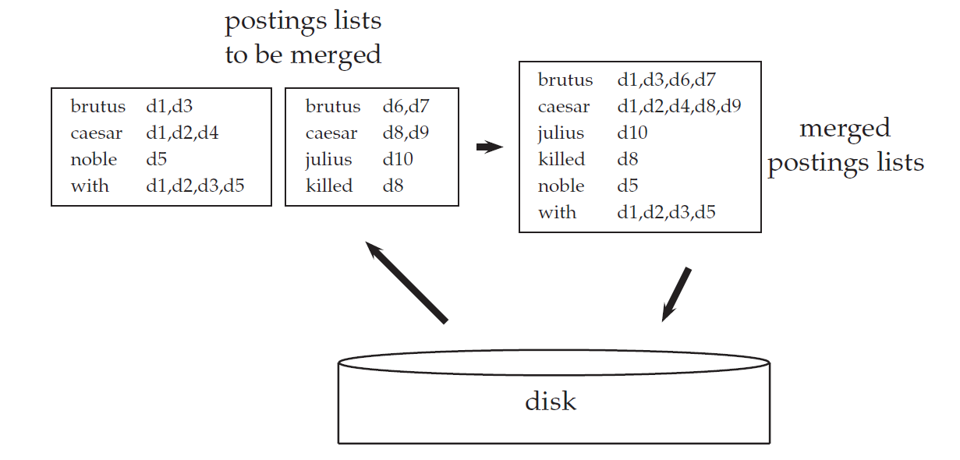
BSBI Example with two blocks: The two blocks (“postings lists to be merged”) are loaded from disk into memory, merged in memory (“merged postings lists”) and written back to disk. Terms are shown instead of termIDs for better readability.

Slide 22
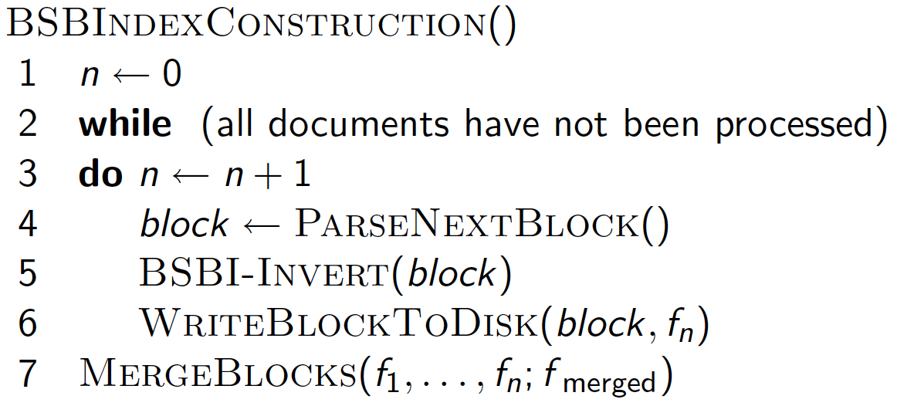
Block number
Sorting the block
File fn
Binary /multiway merge
Inversion involves 2 steps:
Sort the termID - docID pairs
Collect all termID – docID pairs with the same termID into a postings list

Slide 23
M way merge
-----
------
------
.
.B1
------
-----
------
------
.
-----
------
------
.
.
------
-----
------
------
.
.
------
-----
------
------
.
.
-----
------
------
.
.
------
-----
------
------
.
.
------
B1
B2
B3
B4
B5
B6
B7
-----
------
------
.
.
------
-----
------
------
.
.
------
-----
------
------
.
.
------
B8
B9
B10

Slide 24
Problem with Sort-Based Algorithm
Assumption: we can keep the dictionary in memory.
We need the dictionary (which grows dynamically) in order to implement a term to termID mapping.
Actually, we could work with (term, docID) postings instead of (termID, docID) postings . . .
. . . but then intermediate files become very large. (We would end up with a scalable, but very slow index construction method.)

Slide 25
Single Pass in-memory indexing
an algorithm that has even better scaling properties because it does not hold the vocabulary in memory.
Key idea 1: Generate separate dictionaries for each block – no need to maintain term-termID mapping across blocks.
Key idea 2: Don’t sort. Accumulate postings in postings lists as they occur.
With these two ideas we can generate a complete inverted index for each block.
These separate indexes can then be merged into one big index.

Slide 26
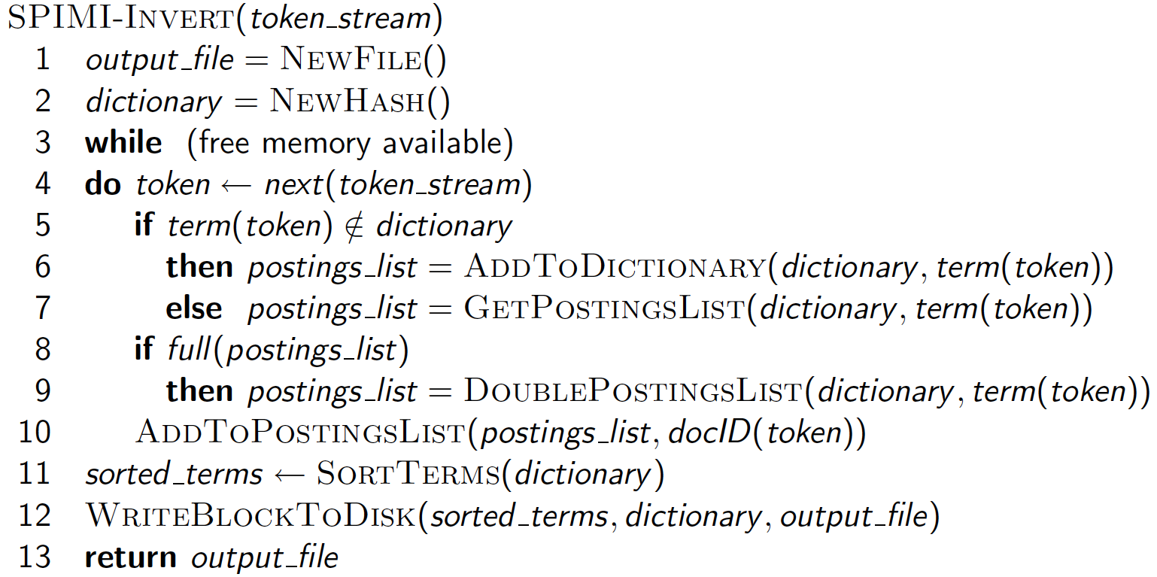
Single Pass in-memory indexing
Next (term,docid) pair

Slide 27
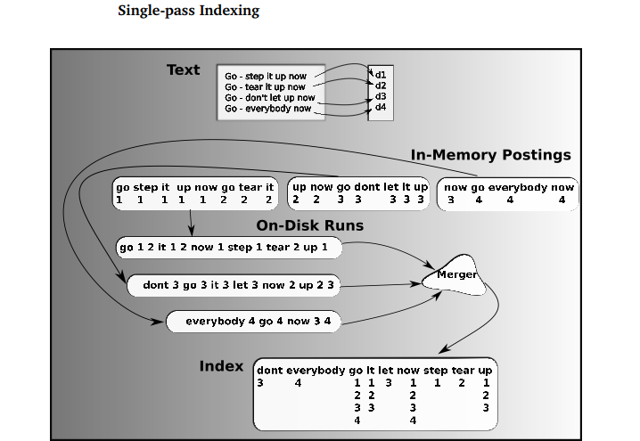

Slide 28
Indexing Types
Basic Sort-based indexing
Blocked Sort-based indexing
Single-pass in-memory indexing
Distributed indexing
Dynamic indexing

Slide 29
Distributed Indexing

Slide 30
Distributed indexing
Data fits into memory, hard disk of a single machine
Data does not fit in to hard disk of a single machine -Web scale indexing
Work with computer cluster - cluster of nodes
A machine can fail or slowdown – fault tolerance
Distributed computing – computing task is distributed across multiple machines
Multiple data centres (data centre with multiple machines)- massive data centres

Slide 31
Types of partitions
Term partition indexing
Document partitioning indexing
How to choose - Load balancing
Term-based index partitioning - distributed global indexing
Document-based partitioning - distributed local indexing
Term1, Term2, .. Term5
Term6, Term7 .. Term10
Term96, Term97 .. Term100
Doc1, Doc2, .. Doc5
Doc6, Doc7, .. Doc10
Doc96, Doc97, .. Doc100

Slide 32
Distributed indexing
Cluster has one master and multiple worker machines
Breaking up indexing into sets of (parallel) tasks
Master machine schedules the task to worker machines
Divides the input document collection into splits

Slide 33
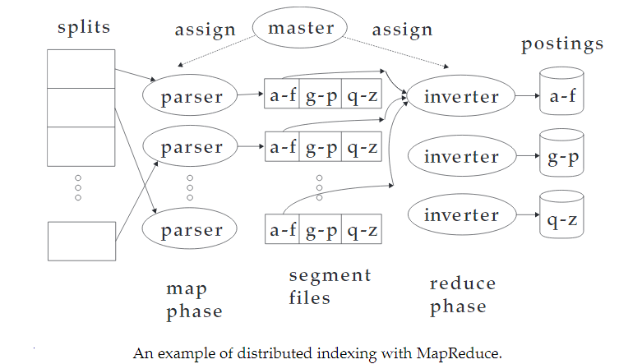
Term,docID
J partitions, j=3

Slide 34
Schema for index construction - MapReduce
Schema of map and reduce functions
map: input → list(k, v)
reduce: (k, list(v)) → output
Instantiation of the schema for index construction
map: collection → list(termID, docID)
reduce: (<termID1, list(docID)>,
<termID2, list(docID)>,
…)
→ (postings list1, postings list2, …)
Key : term ; Value : DocID
The reduce will take keys of each partition, and combines the values of each particular key and aggregates (sort/sum/count …. etc)

Slide 35
MapReduce
The index construction algorithm - MapReduce.
MapReduce (Dean and Ghemawat 2004) is a robust and conceptually simple framework for distributed computing …
They describe the Google indexing system (ca. 2002) as consisting of a number of phases, each implemented in MapReduce.

Slide 36
Example for MapReduce
Map
d1 : C came, C c’ed.
d2 : C died. →
<C,d1>, <came,d1>, <C,d1>, <c’ed, d1>, <C, d2>, <died,d2>
Reduce
(<C,(d1,d1,d2)>, <died,(d2)>, <came,(d1)>, <c’ed,(d1)>)
→ (<C,(d1:2,d2:1)>, <died,(d2:1)>, <came,(d1:1)>, <c’ed,(d1:1)>)

Slide 37
Indexing Types
Basic Sort-based indexing
Blocked Sort-based indexing
Single-pass in-memory indexing
Distributed indexing
Dynamic indexing

Slide 38
Dynamic Indexing

Slide 39
Dynamic indexing
collections that change infrequently or never (e.g., the Bible or Shakespeare)
Static collections – rare
Documents come in over time and
need to be inserted.
Documents are deleted and modified.
Dictionary and postings lists have to be modified:
New terms added to dictionary
Postings updates for terms already in dictionary
Dynamic collections
Plan : periodically reconstruct the index from scratch.
Good - if the number of changes over time is small
- a delay in making new documents searchable is acceptable
- if enough resources are available to construct a new index while the old one is still available for querying.

Slide 40
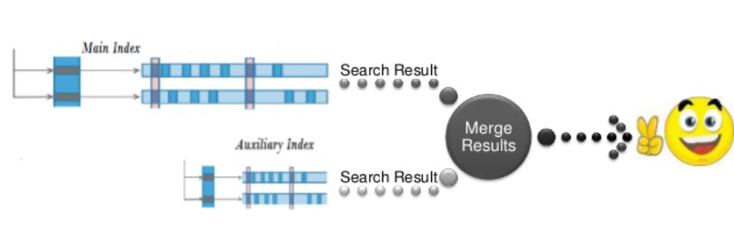
Simplest Index
Maintain “big” main index
New docs go into “small” auxiliary index
Search across both, merge results
Deletions
Invalidation bit-vector for deleted docs
Filter docs output on a search result by this invalidation bit-vector
Periodically, re-index into one main index

Slide 41
Issues with main and auxiliary indexes
Problem of frequent merges – cost of merge depends on how we store index in the file system
Separate file for each posting list – lot of files - Merging of the auxiliary index into the main index – M_{avg} disk seeks - average size of the vocabulary of documents in the collection.
Large single file for the entire index – Assumption

Slide 42
Logarithmic merge
Instead of two indexes – maintain multiple indexes – each twice as large as the previous one
Keep smallest (Z₀) in memory, Larger ones(I₀, I₁, I₂ , ..) on disk
If Z₀ gets too big (>n) write to disk as I₀ or merge with I₀ as I₁
Either write Z₁ to disk as I₁ or merge with I₁ as Z_{2 …..}
I_{k}
I₃
I₂
I₁
I₀
. . .
8
4
2
1

Slide 43
Z₀
Z₀ → I₀
Z₀+I₀ → Z₁ → I₁
I₀
Z₀ → I₀
Z₀+I₀ →I₁
I₁+I₁ → Z₂ → I₂
I₁
I₀
Z₀ → I₀
Z₀+I₀ → I₁
Z₀ → I₀
Z₀+I₀ → Z₁ → I₁
I₁+I₁ → Z₂ → I₂
I₂+I₂ → Z₃ → I₃
I₀ I₁ I₂

Slide 44
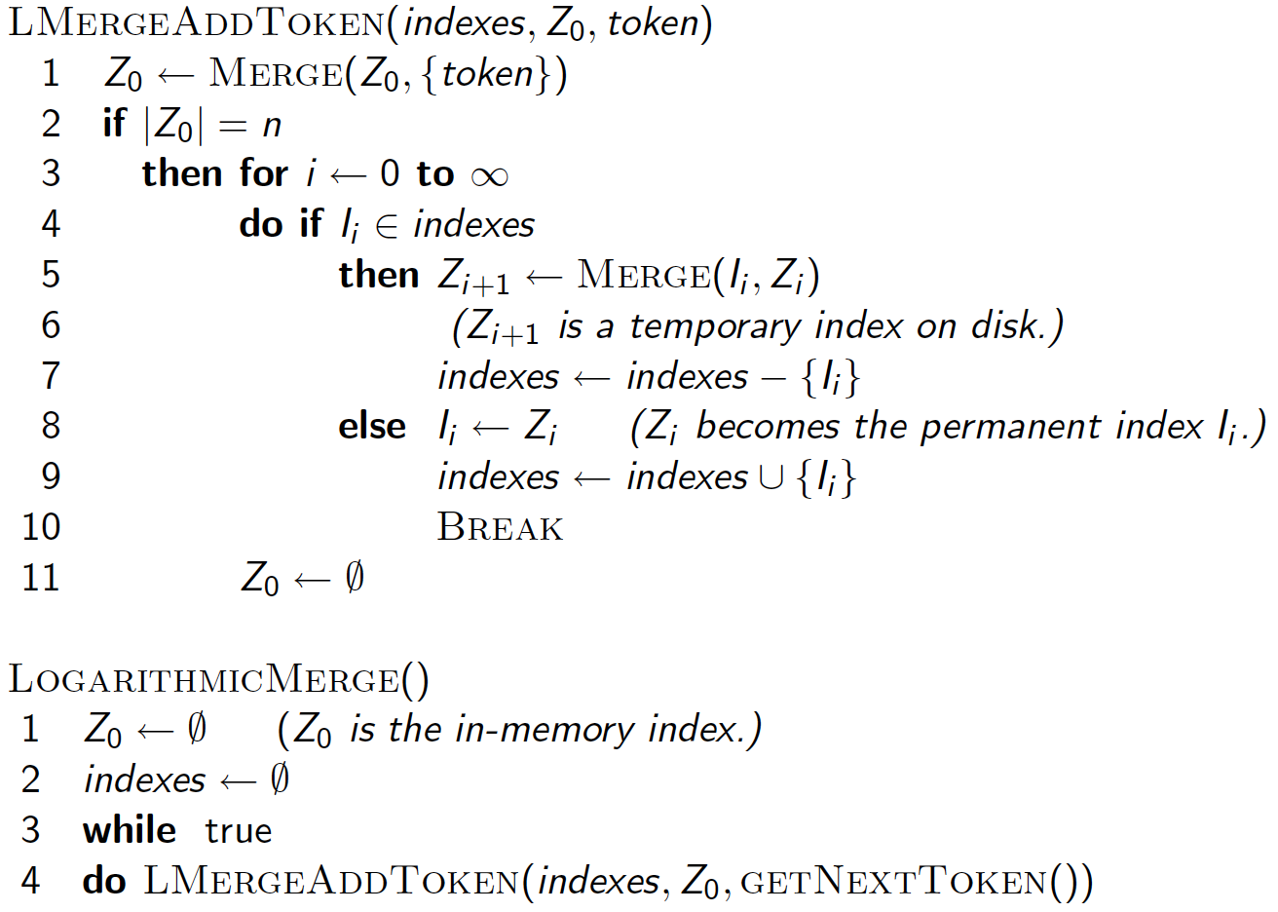

Slide 45
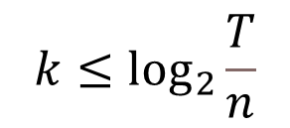





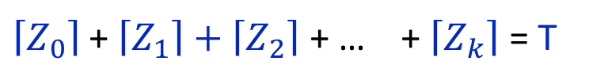


Logarithmic merge
What is the number of indexes according to logarithmic merge?
$\left\lceil Z_{0}\right\rceil ≤n$
$\left\lceil Z_{1}\right\rceil ≤2n$
Sum of all indexes =T, Total number of postings
$$\left\lceil Z_{2}\right\rceil ≤4n$$
$\left\lceil Z_{0}\right\rceil$ + $\left\lceil Z_{1}\right\rceil +\left\lceil Z_{2}\right\rceil$ + … + $\left\lceil Z_{k}\right\rceil$ = T
$$\left\lceil Z_{k}\right\rceil ≤2^{k}n$$
$\left\lceil Z_{k}\right\rceil ≤2^{k}n≤T$
$$2^{k}n≤T$$
➔
$$k≤\log_{2}{\frac{T}{n}}$$
$$k≤\log_{2}{T, n≥1}$$

Slide 46
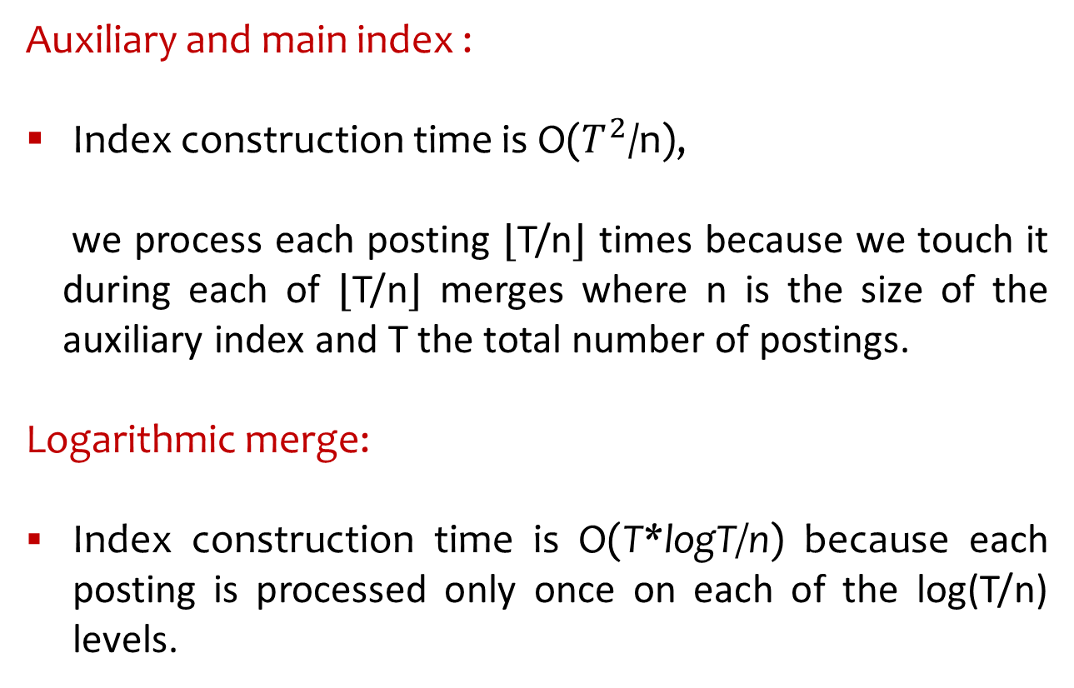
Auxiliary and main index :
Index construction time is O($T^{2}$/n),
we process each posting ⌊T/n⌋ times because we touch it during each of ⌊T/n⌋ merges where n is the size of the auxiliary index and T the total number of postings.
Logarithmic merge:
Index construction time is O(T*logT/n) because each posting is processed only once on each of the log(T/n) levels.

Slide 47
Dynamic Indexing
All the large search engines now do dynamic indexing
Their indices have frequent incremental changes - News items, blogs, new topical web pages
But (sometimes/typically) they also periodically reconstruct the index from scratch
Query processing is then switched to the new index, and the old index is then deleted

Slide 48
Other Indexes
Positional indexes
Same sort of sorting problem … just larger
Building character n-gram indexes:
As text is parsed, enumerate n-grams (sequence of n chars) .
For each n-gram, need pointers to all dictionary terms containing it – the “postings”

Slide 49
Summary
Sort-based indexing
Naïve in-memory inversion
Blocked Sort-Based Indexing
Merge sort is effective for disk-based sorting
Single-Pass In-Memory Indexing
No global dictionary
Generate separate dictionary for each block
Don’t sort postings
Accumulate postings in postings lists as they occur
Distributed indexing using MapReduce
Dynamic indexing: Multiple indices, logarithmic merge

